Slide 1

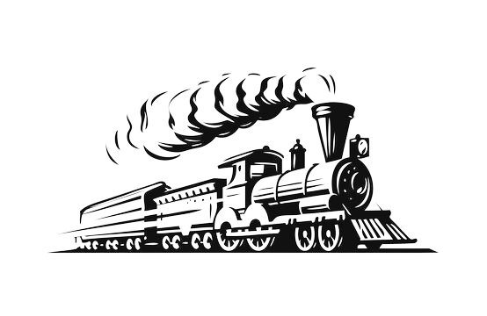
Building with AutoTrain
Exploration

Slide 2
Table of contents
01
02
03
04
Introduction AutoTrain
Various Features of AutoTrain & Hands-on
Usecases of AutoTrain
Limitations & Future Directions

Slide 3

01
Introduction to AutoTrain

Slide 4
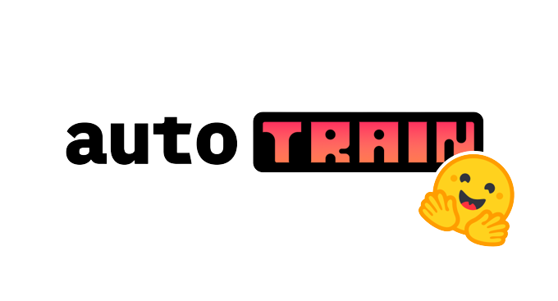
What is
AutoTrain is machine learning tool developed by Hugging Face that automates the training and optimization of machine learning models.
Quickly and easily train models without configuring hyperparameters, loss functions, etc.
Supports various types of machine learning tasks like classification, regression, and sequence labeling.
Supports automatic model selection and hyperparameter tuning to optimize model performance.

Slide 5
When to use Autotrain:
Rapid Prototyping – Helps you high quality model in a short amount of time.
Resource Limitation - Automate the process of hyperparameter tuning, which is time consuming and resource intensive.
Quick Model Analysis - Autotrain Huggingface can help you quickly create and evaluate multiple models.
Autotrain Hf can be beneficial where you need to train a high-quality model quickly and with limited resources, or when you need to explore multiple models.

Slide 6
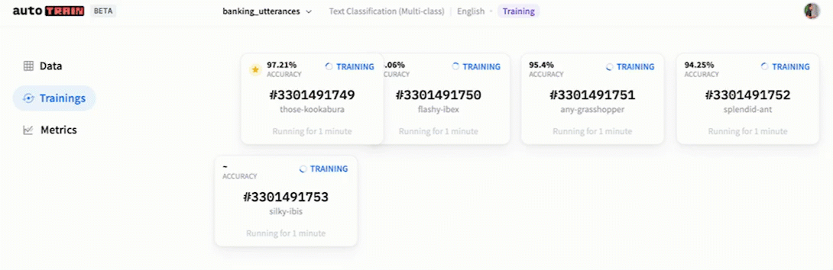
Advantages of AutoTrain
Automated Hyperparameter Tuning
Evaluation metrics for the model
Community Support
Cost Effectiveness
Easy to Use
Time Efficient
Less Resource Intensive
Improved Model Performance

Slide 7
Best Part about Autotrain: Deployment

Slide 8

02
Various Features of AutoTrain

Slide 9
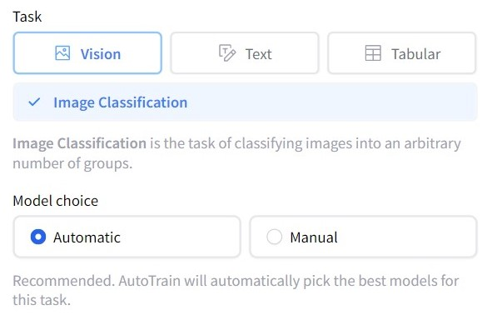
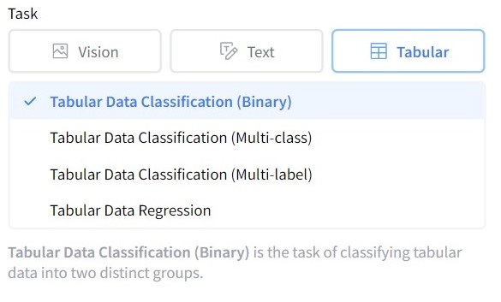
Various Task in AutoTrain

Slide 10
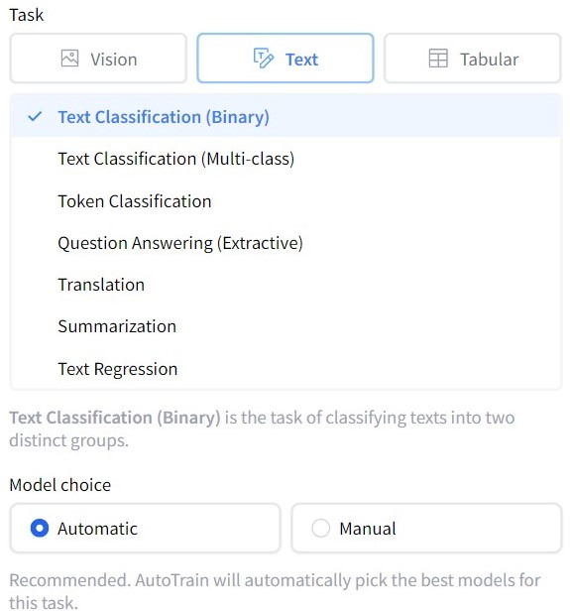
Various Task in AutoTrain

Slide 11
03
Real Life Usecases AutoTrain

Slide 12

Real Life Usecases
Walmart
models that can predict which products will sell best in its stores
Sofi
models that can predict which customers are likely to default their loans
Capital One
models that can detect fraudulent credit card transactions

Slide 13
04
Limitation & Disadvantages

Slide 14
Disadvantages & Limitation
Limited Customization
Overfitting Possibility
Limited Scope
Limited Model Selection

Slide 15
Thanks!

